Slide 1

Book your flights in
7 simple Steps

Slide 2
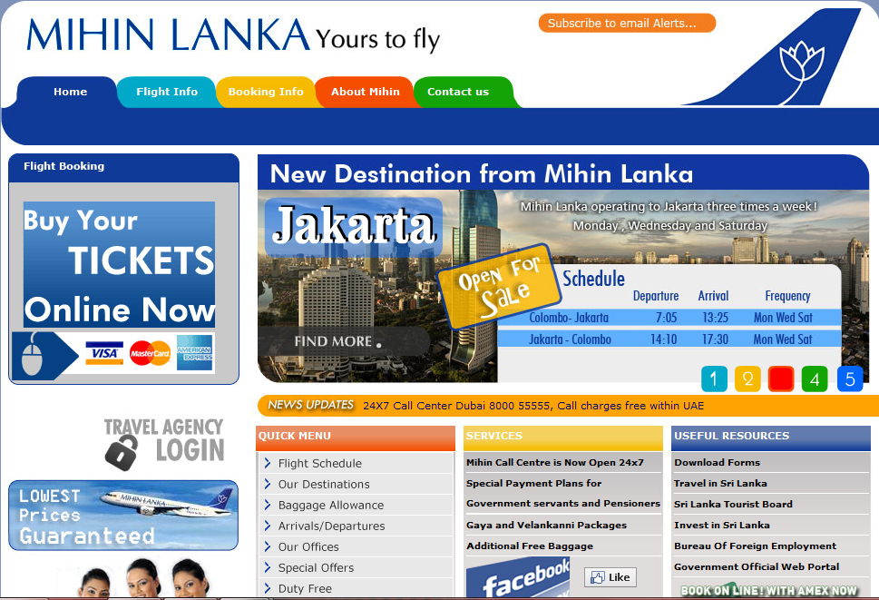
Click Here to Book

Slide 3
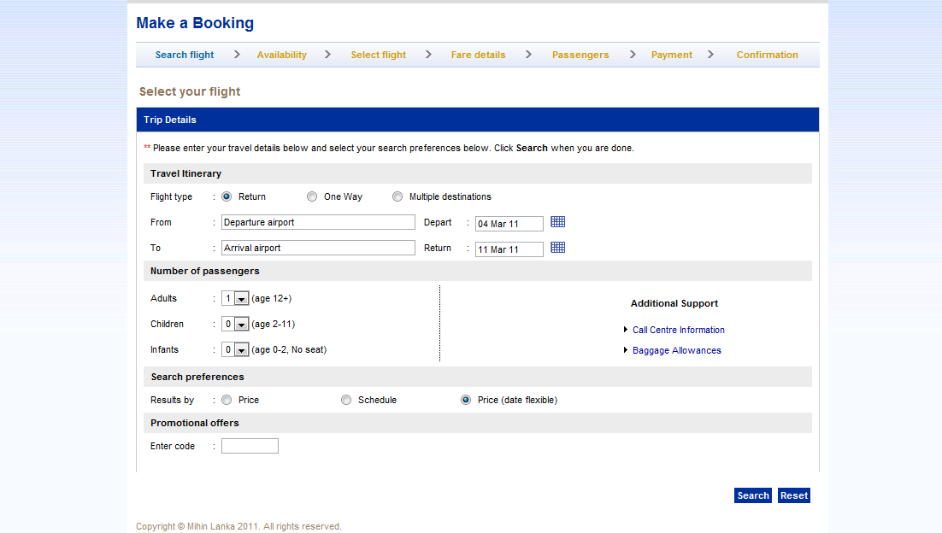
Step 1 – Make a Booking
Select your city of Departure and Arrival
Select the number of Passengers you are booking for
Click Here to Search Flights

Slide 4
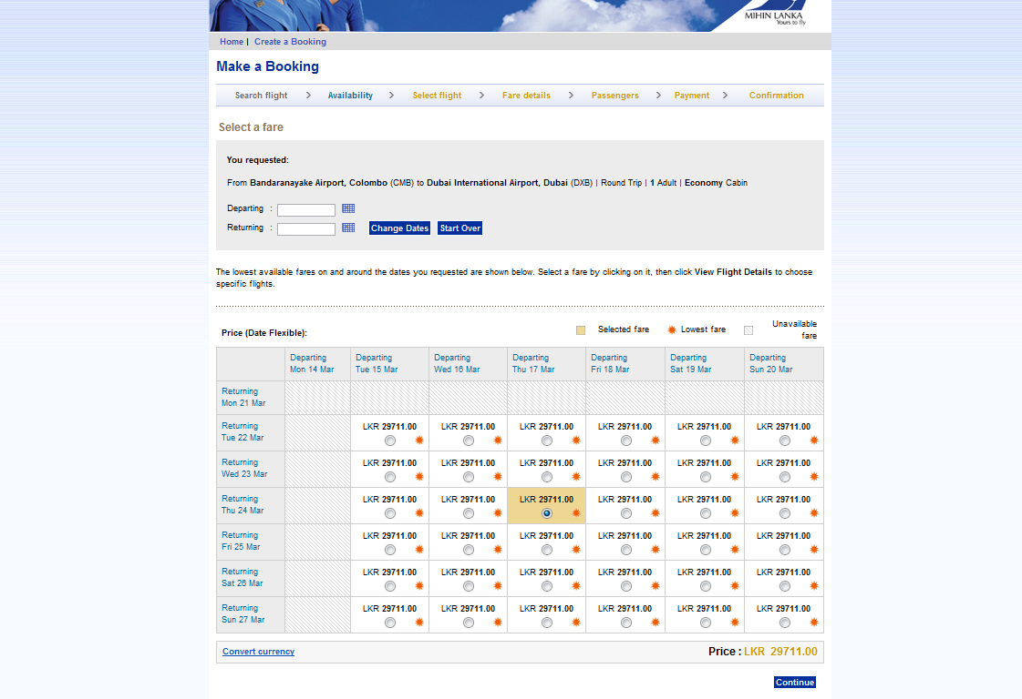
Step 2 – Select Available Flight
Select the available flight that you require from the table below
Click Here to Proceed

Slide 5
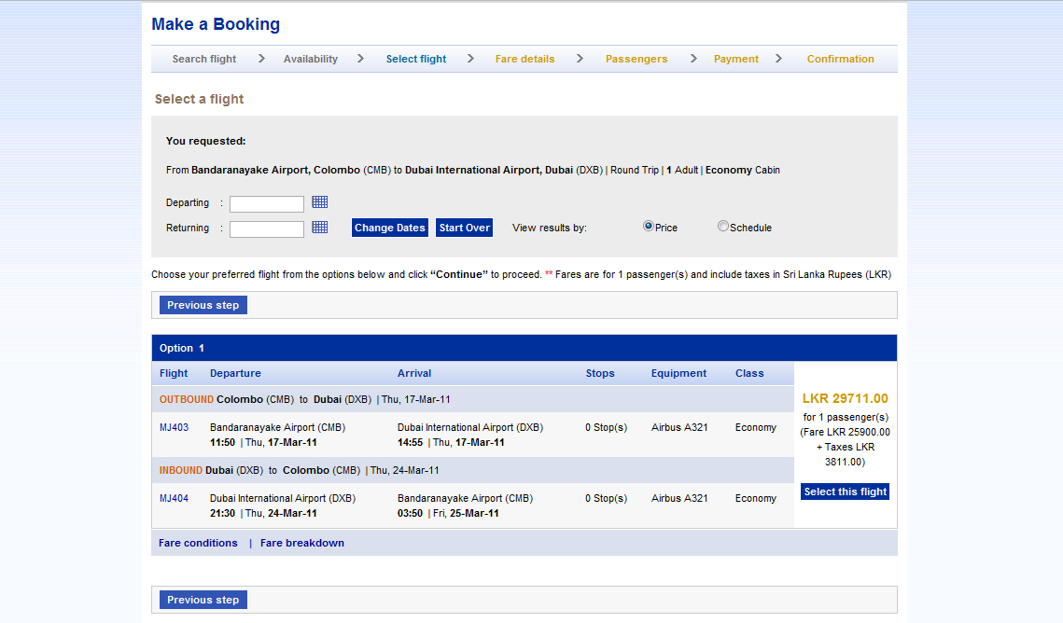
Step 3 – Flight Summary
View the Flight Summary Here for the Selected Booking
Click Here to Proceed

Slide 6
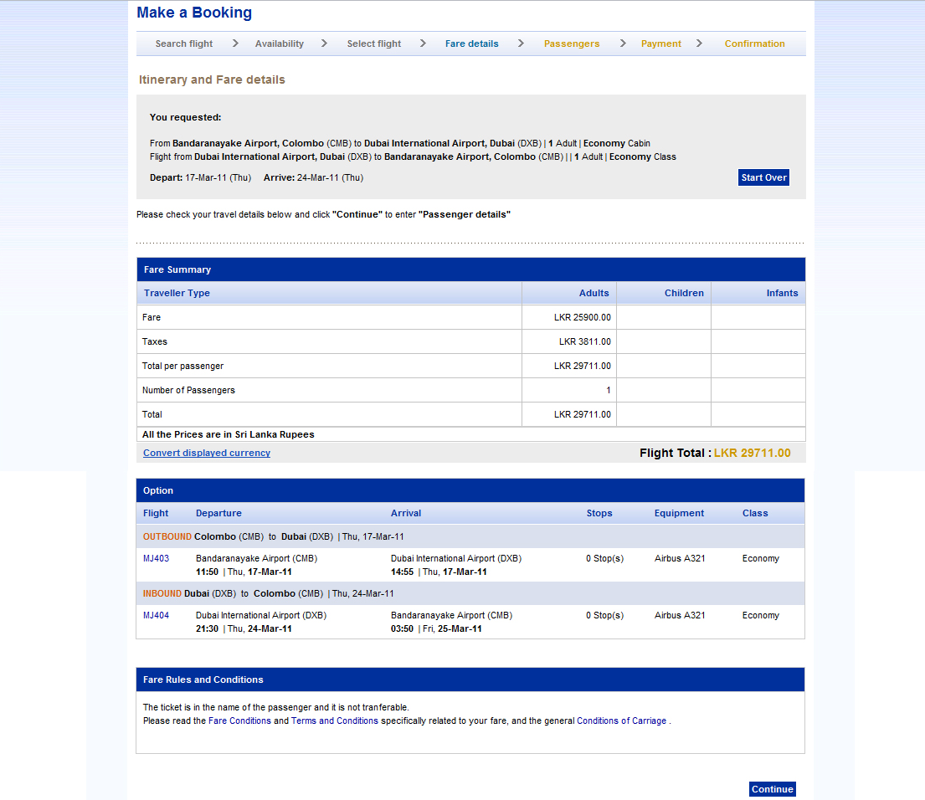
Step 4 – Fare Details
View Fare details and total price of your booking
Click Here to Proceed

Slide 7
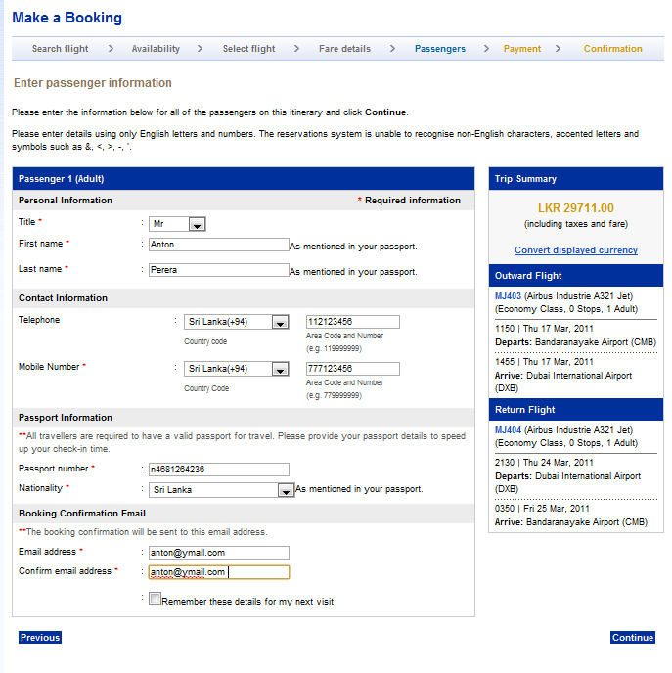
Step 5 – Passenger Details
Enter the Passenger Details of the Travellers and don't forget to include Passport Numbers
Click Here to Proceed

Slide 8
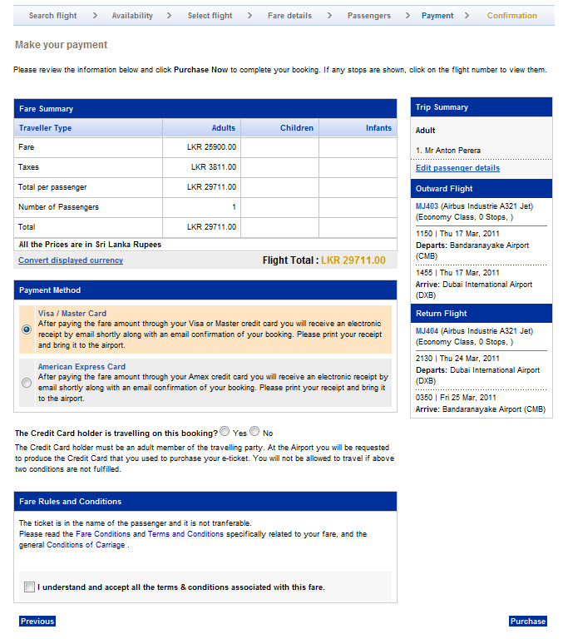
Step 6 – Booking Summary
Review the total fare for the booking
Select Card Payment Option
Click Here to Proceed

Slide 9
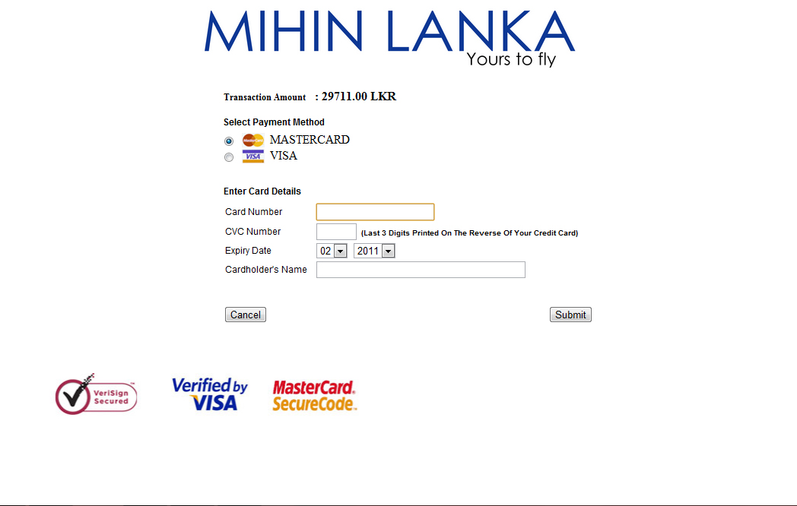
Step 7 – Payment
Enter your Credit Card Details Here
Click Here to Proceed

Slide 10
Other Information
Is the Credit Card Holder Travelling with you?
If not, please download and fill the Indemnity form available online else you may be denied onboard your flight.
Indemnity form
Copy of the Credit Card both front and back with out CVC number
Copy of Passport or Nic
All the above are to be forwarded to bookings@mihinlanka.com
Want further assistance with your booking?
Contact us on bookings@mihinlanka.com or call us on +94 112 00 22 55 so we can help you further

